Slide 1
IoT based Water Quality Assistant for Irrigation
CPG-101
Umang Sharma (101983043)
Suryansh Bhardwaj (101983044)
Prakhar Srivastava (101983045)
Mentor: Dr. Karun Verma

Slide 2
Problem Statement
Currently water quality is monitored through time consuming laboratory methods and with various costly sensors having low sensitivity which delays any action and is highly inefficient.
Our team proposes a cost effective and scalable solution where, with the help of machine learning models and sensors, water quality will be calculated and if it is unsuitable for irrigation, it would be redirected to a treatment facility.
Project scope
Farming sector is a billion dollar industry which accounts for almost 15% contribution to the GDP of India
A large number of farmers are still dependent on fresh water for their crops. The water is derived from one of the natural sources and often requires treatment to ensure good quality of water for the crops.
Our solution can be of huge help in providing farmers with a constant flow of suitable irrigation water and thereby reducing their dependency on artificial fertilizers to ensure their yield.

Slide 3
Project Objectives
Integrate different sensors and Wi-Fi module with an IoT device
Process data from different sensors, calibrate their readings and send it to web portal using the IoT device.
Develop an interactive web dashboard to tabulate live readings from the sensors for the user.
Perform analysis of data gathered from different sensors and determine water quality and classify it as good quality or bad quality.
• To process data from different sensors like SAR sensor, pH sensor humidity sensor etc. calibrate the readings and send it to web portal using the IoT device.
• To develop an interactive web dashboard to tabulate live readings from the sensors for the user.
• To perform analysis of data gathered from different sensors to determine quality of water and to classify water as good quality or bad quality and to generate a corresponding signal to IoT device to turn on the appropriate water pump, i.e., treatment pump (in case of bad-quality water) or field water pump (in case of good-quality water).
-Fi module with an IoT device and build a cost-effective hardware setup [8].
To process data from different sensors like SAR sensor, pH sensor humidity sensor etc. calibrate the readings and send it to web portal using the IoT device.
To develop an interactive web dashboard to tabulate live readings from the sensors for the user.
To perform analysis of data gathered from different sensors to determine quality of water and to classify water as good quality or bad quality and to generate a corresponding signal to IoT device to turn on the appropriate water pump, i.e., treatment pump (in case of bad-quality water) or field water pump (in case of good-quality water).

Slide 4
LITERATURE SURVEY INDICES USED FOR WATER QUALITY MONITORING
Sodium Absorption Ratio
pH
Turbidity
Temperature
Chemical Oxygen Demand
Dissolved Oxygen
Salinity
Electrical Conductivity
Total Nitrogen
Biochemical Oxygen Demand
Total Phosphorus
Oxygen Reduction Potential

Slide 5
RESEARCH WORK
 | Features | Technology used | Miscellaneous
Shafi et al. | Temperature,pH, Turbidity | SVM, KNN, Deep NN | Deep NN had the highest accuracy
Zin et al. | Temperature, pH, Turbidity, Carbon Dioxide | Wireless sensor network using Zigbee, FPGA | IoT
Saravanan et al. | Turbidity, Temperature and Colour | Employed a GSM module for wireless Data Transfer | SCADA system enabled by IoT

Slide 6
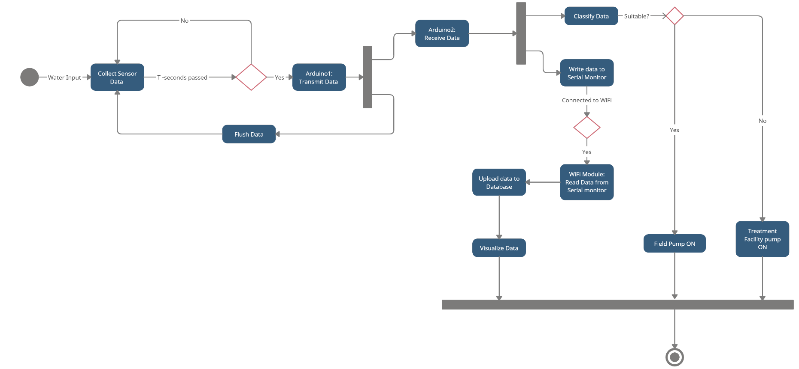
State Diagram

Slide 7
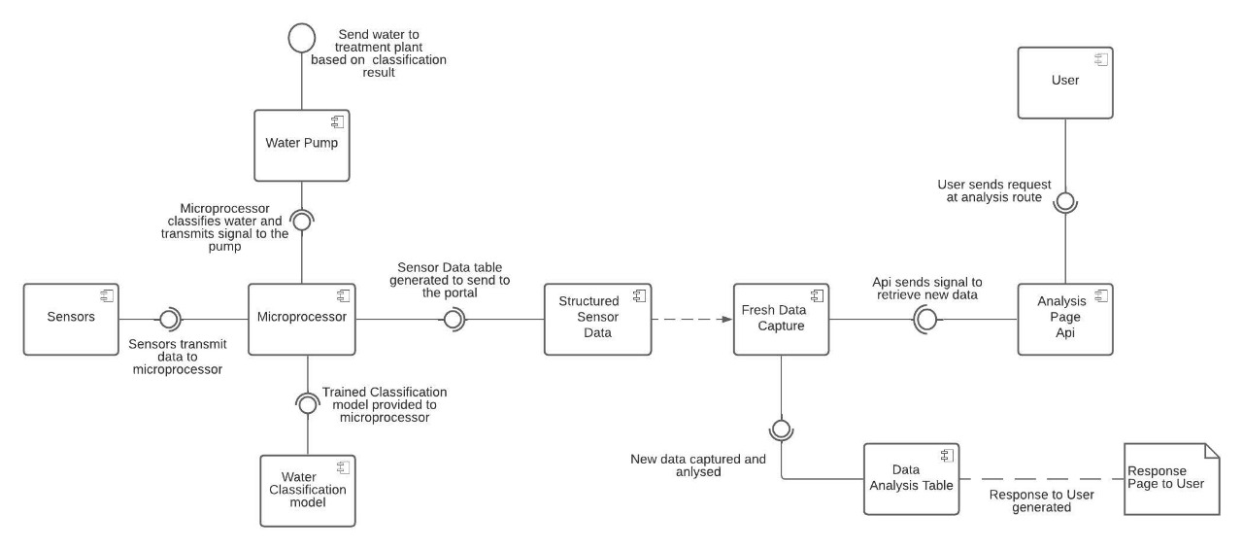
Component Diagram

Slide 8
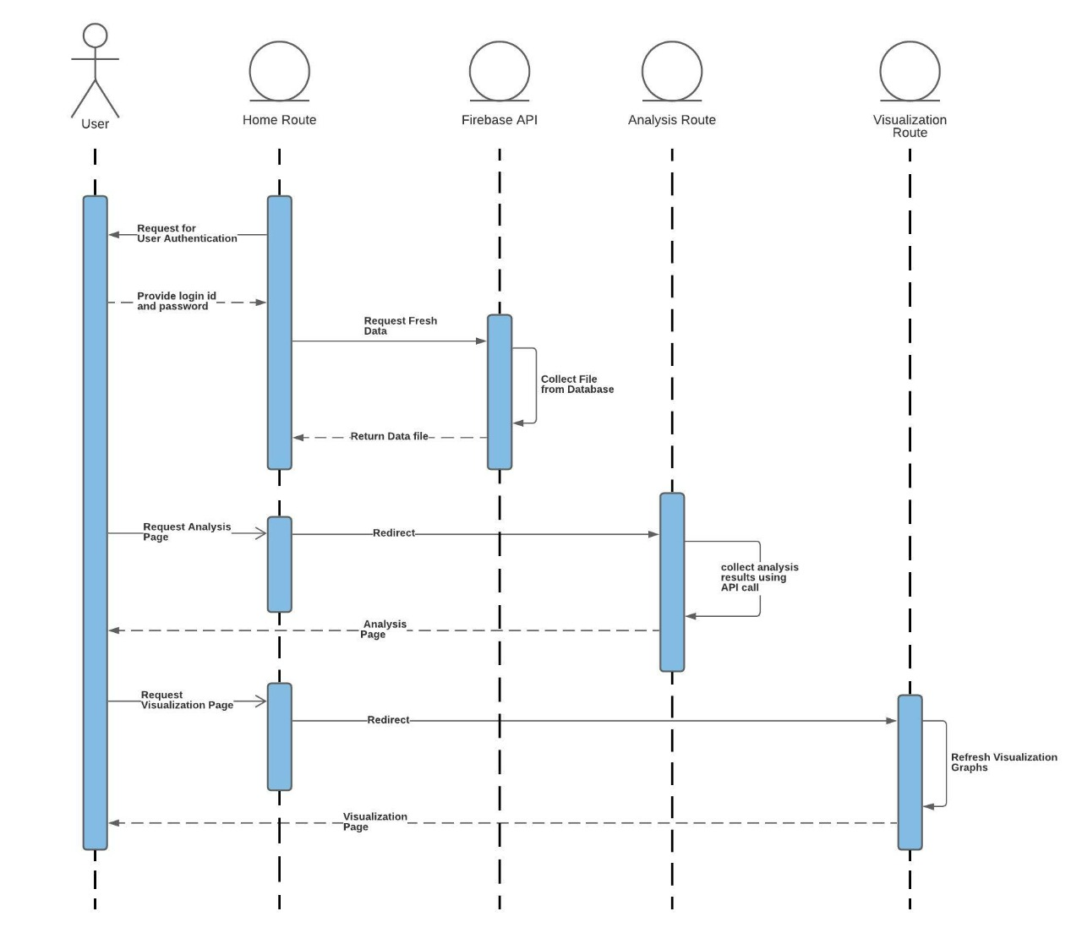

Slide 9
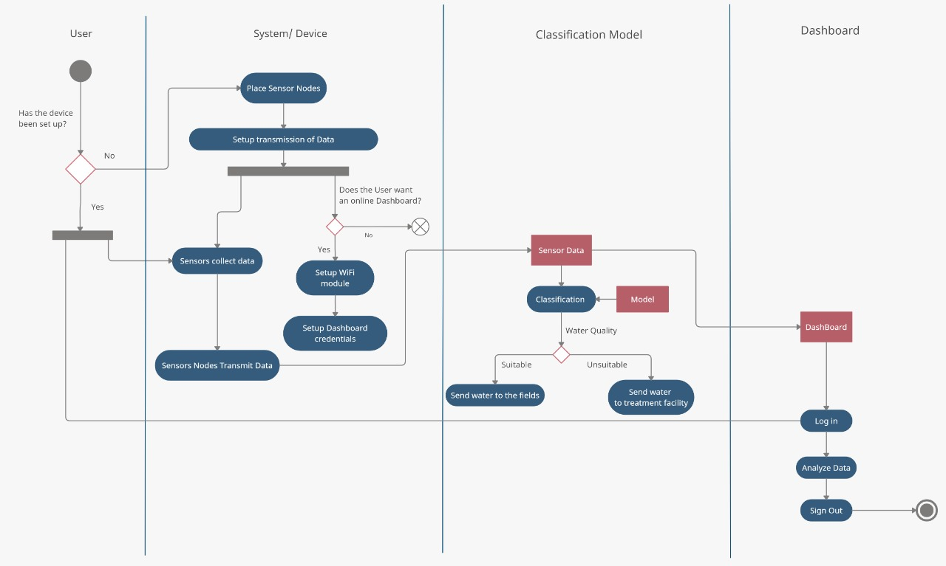
Activity Diagram

Slide 10
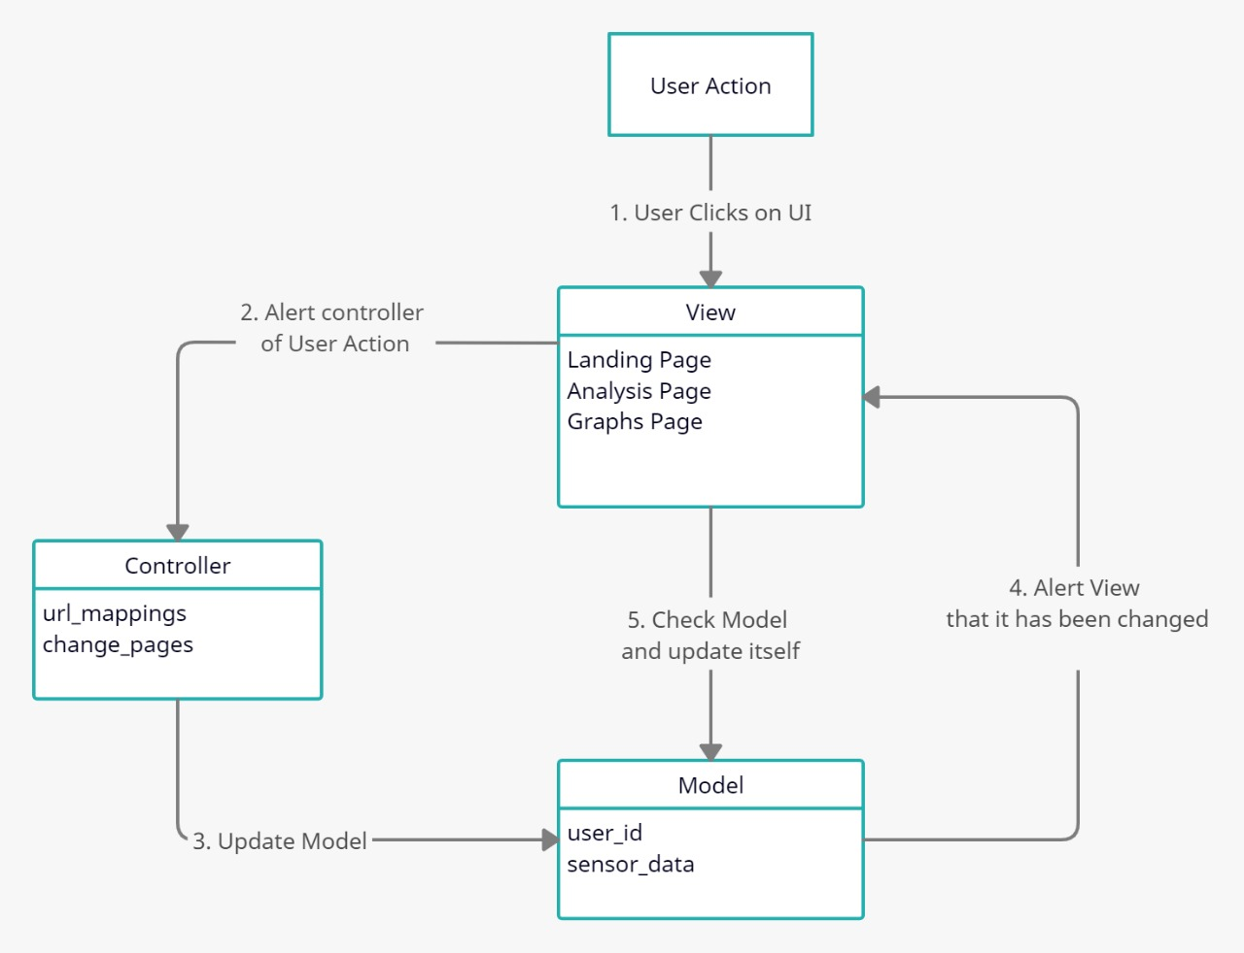
DESIGN
Tools used
Figma
FireBase
Django
Charts.js

Slide 11
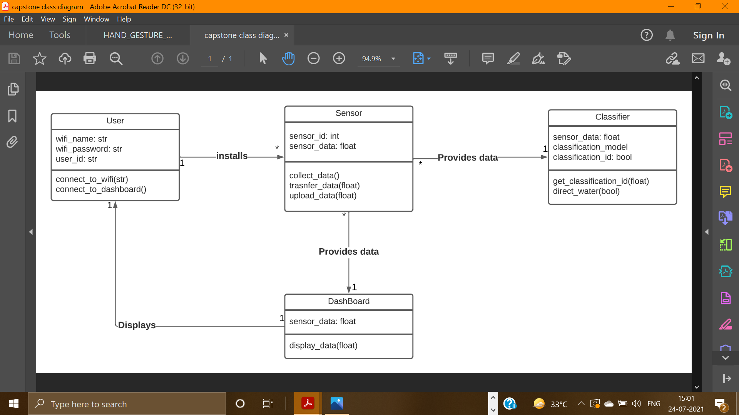
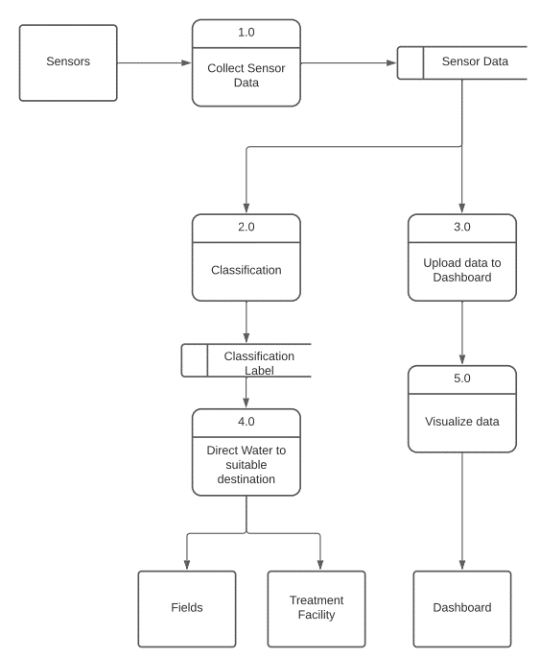
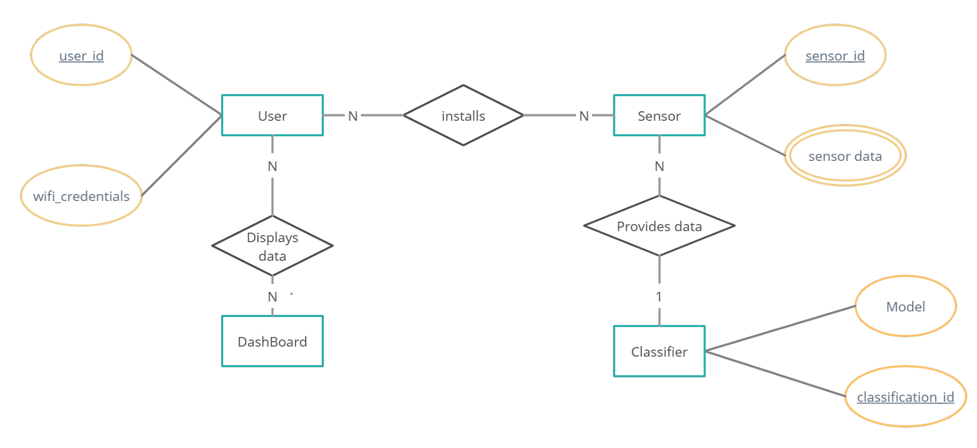

Slide 12
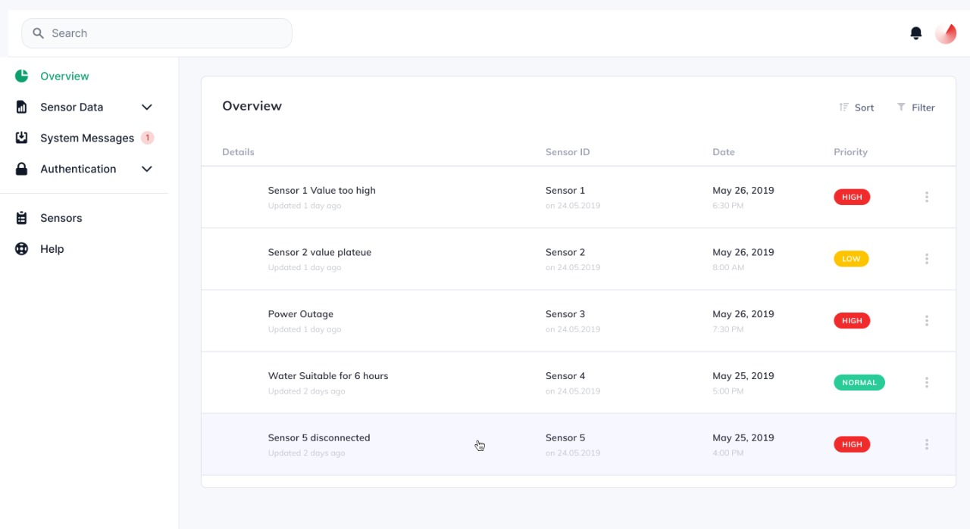
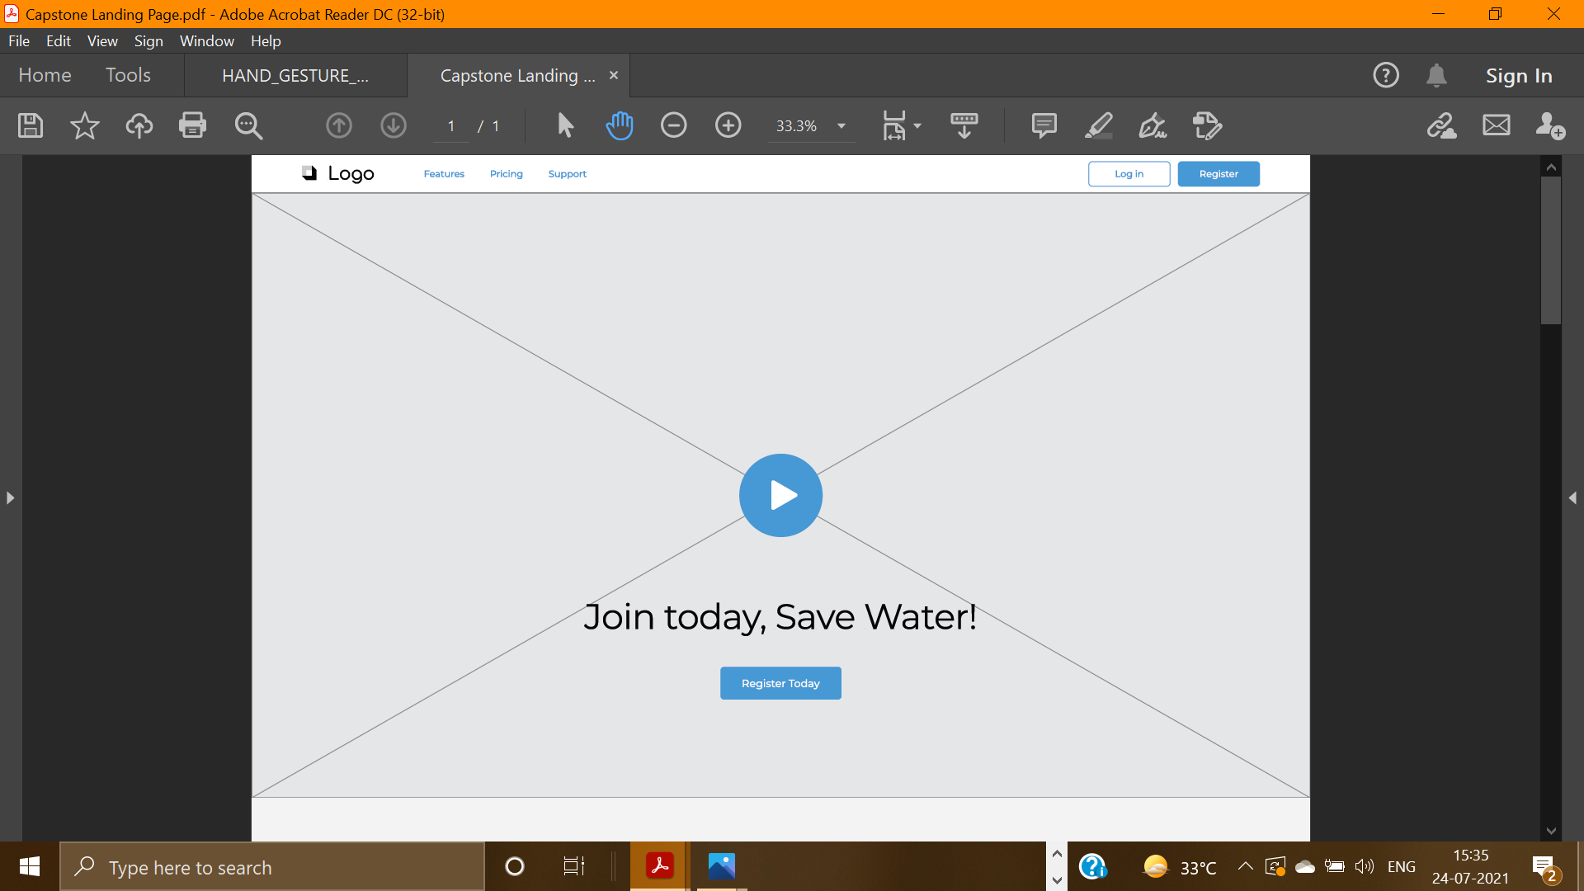
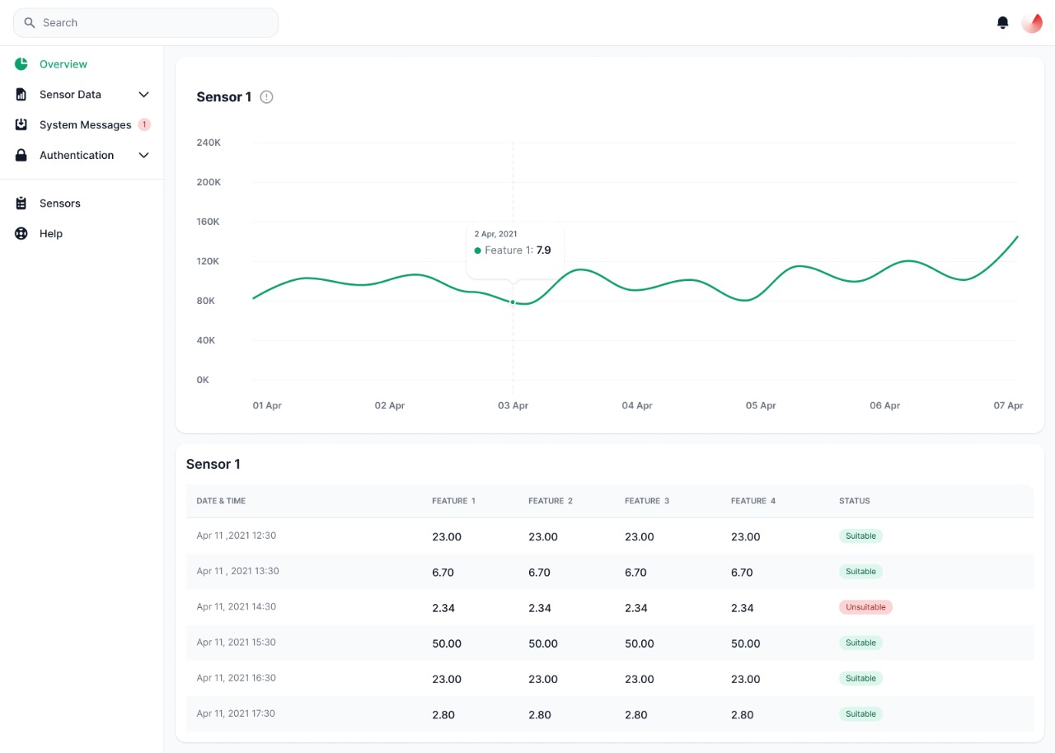
Interfaces

Slide 13
LORA modules Rs. 375
Arduino Uno Rs. 585
Water flow sensor Rs. 749
Cost Breakup
ESP8266 WiFi Module
Rs. 165
Temperature Sensor
Rs. 95
pH sensor Rs. 1095
Turbidity sensor Rs. 745

Slide 14
Project Outcomes
Using machine learning, the data collected will be analyzed.
A working online dashboard would be designed where the data can be uploaded and accessed by the user as and when required
The capstone project is intended to help determine if the water quality is good enough to be used for irrigation, thus, leading to increase in yield of crops quantitatively as well as qualitatively.

Slide 15
Role of each Team Member
Umang Sharma
Team Leader
Implementation of backend
Collaborating the different technologies used in the project and the hardware and sensors used
Suryansh Bhardwaj
Exploration and Implementation of the various Machine Learning algorithms that can be used and applied onto the data collected.
Prakhar Srivastava
Exploration and creation of the User Interface for the online Dashboard

Slide 16
Activity | March | April | May |  | June | July |  | August | September | October |  | November
Backend
User Interface
Integration of IoT device with backend
ML model
Evaluation
Final Report

Slide 17
REFERENCES
Sophia Karastogianni, Stella T. Girousi. pH: Principles and Measurement. December 2016. Available https://www.researchgate.net/publication/301702485_pH_Principles_and_Measurement
E. J. Williamson, Frank Wiersma ,L. O. Fine. A Study of the Sodium Adsorption Ratio and Residual Sodium Carbonate Concepts of Irrigation Waters as They Affect Exchangeable Sodium of Soil Under Semiarid Conditions. Available https://acsess.onlinelibrary.wiley.com/doi/abs/10.2136/sssaj1959.0361599500230004 0011x
IEEE Internet of Things Journal. Issue 6, March15,-2021.Available https://ieeexplore.ieee.org/xpl/mostRecentIssue.jsp?punumber=6488907
B. Das, P. Jain. Real-time water quality monitoring system using internet of things, in 2017 International Conference on Computer, Communications and Electronics (Comptelix), Jaipur, Rajasthan India, 1–2 July 2017. IEEE
J. Shah, An internet of things based model for smart water distribution with quality monitoring. Int. J. Innov. Res. Sci. Eng. Technol. 6(3), 3446–3451 (2017). Available http://dx.doi.org/10.15680/IJI RSET.2017.0603074
G. Bruce Wiersma (2021). Environmental Monitoring and Assessment Vol.193. Available https://www.springer.com/journal/10661

Slide 18
REFERENCES
M.C. Zin, G. Lenin, L.H.Chong, M. Prassana, Real-time water quality system in internet of things, in IOP Conference Series: Materials Science and Engineering, vol 495, no 1, p. 012021 (2019). http://dx.doi.org/10.1088/1757-899X/495/1/012021
K. Saravanan, E. Anusuya, R. Kumar, Real-time water quality monitoring using Internet of Things in SCADA. Environ. Monit. Assess. 190(9), 556 (2018). https://doi.org/10.1007/s10 661-018-6914-x
Alex Keinan , New equipment allows for sampling, testing water in real time(2017).Available https://www.foodengineeringmag.com/articles/96511-newequipment-allows-for-sampling-testing-water-in-real-time
VWM Vienna Water Monitoring Solutions. Source: www.vienna-watermonitoring.com
IEEE Wireless Communications. Issue 1, February-2021.Available https://ieeexplore.ieee.org/xpl/mostRecentIssue.jsp?punumber=77422
Ismail Butun, Nuno Pereira, Mikael Gidlund. Analysis of LoRaWAN v1.1 security: research paper (2018). Available https://www.researchgate.net/publication/325493576_Analysis_of_LoRaWAN_v11_s ecurity_research_paper

Slide 19
THANKS!
Any questions?

